Slide 1



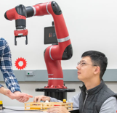
Teachers
BUILDS
Students
DIY Robots
Community
AI Researchers

